Slide 1
CMPE223 [ISYE223] ALGORITHMS AND PROGRAMMING Autumn2024-2025
Lecture 3
Processing Arrays

Slide 2
ARRAYS
Data stored in the computer in a logical way in order to find values as quickly as possible.
The way data stored is called the structure of the data, hence the term data structures.
Using data structures, a single value is stored in a single named location this is the simplest of all data structures.
Array is a group of memory locations related by the fact that they all have the same name and the same type.

Slide 3
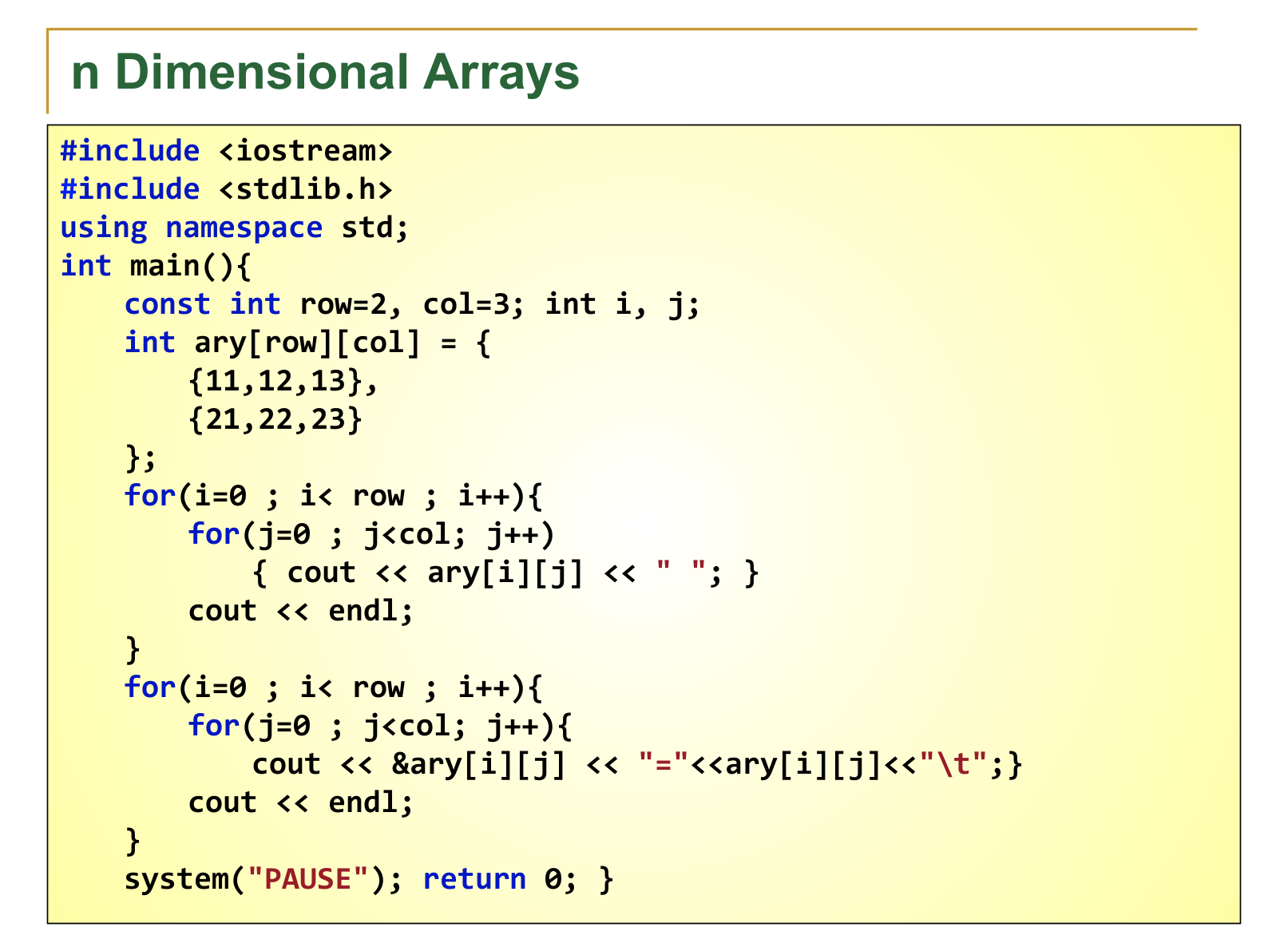

Slide 4
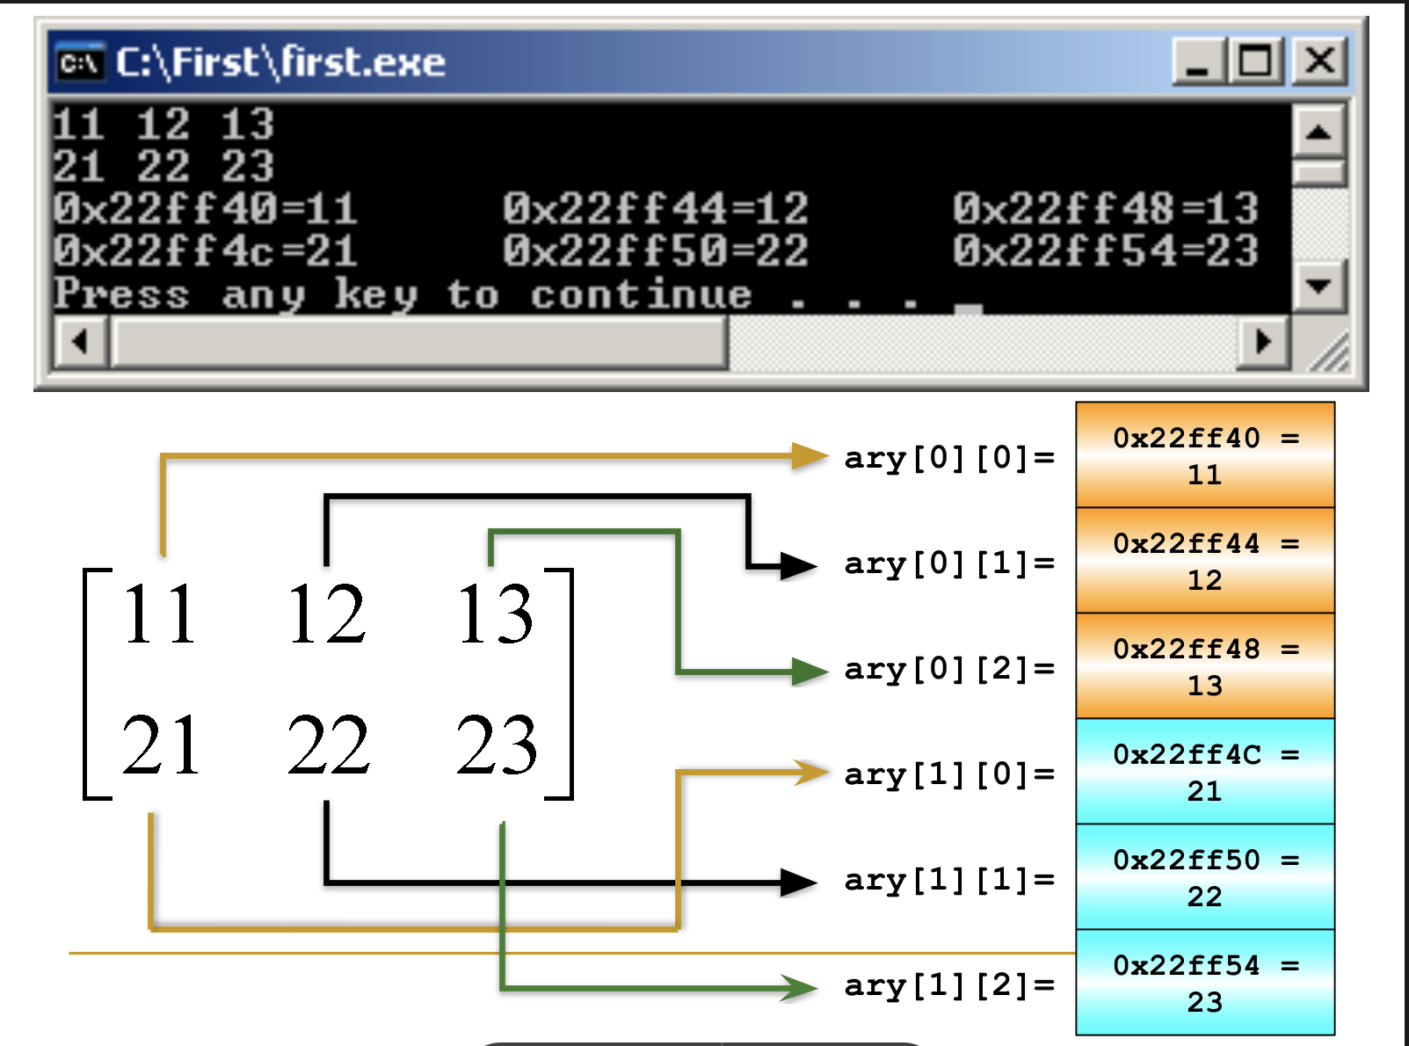

Slide 5
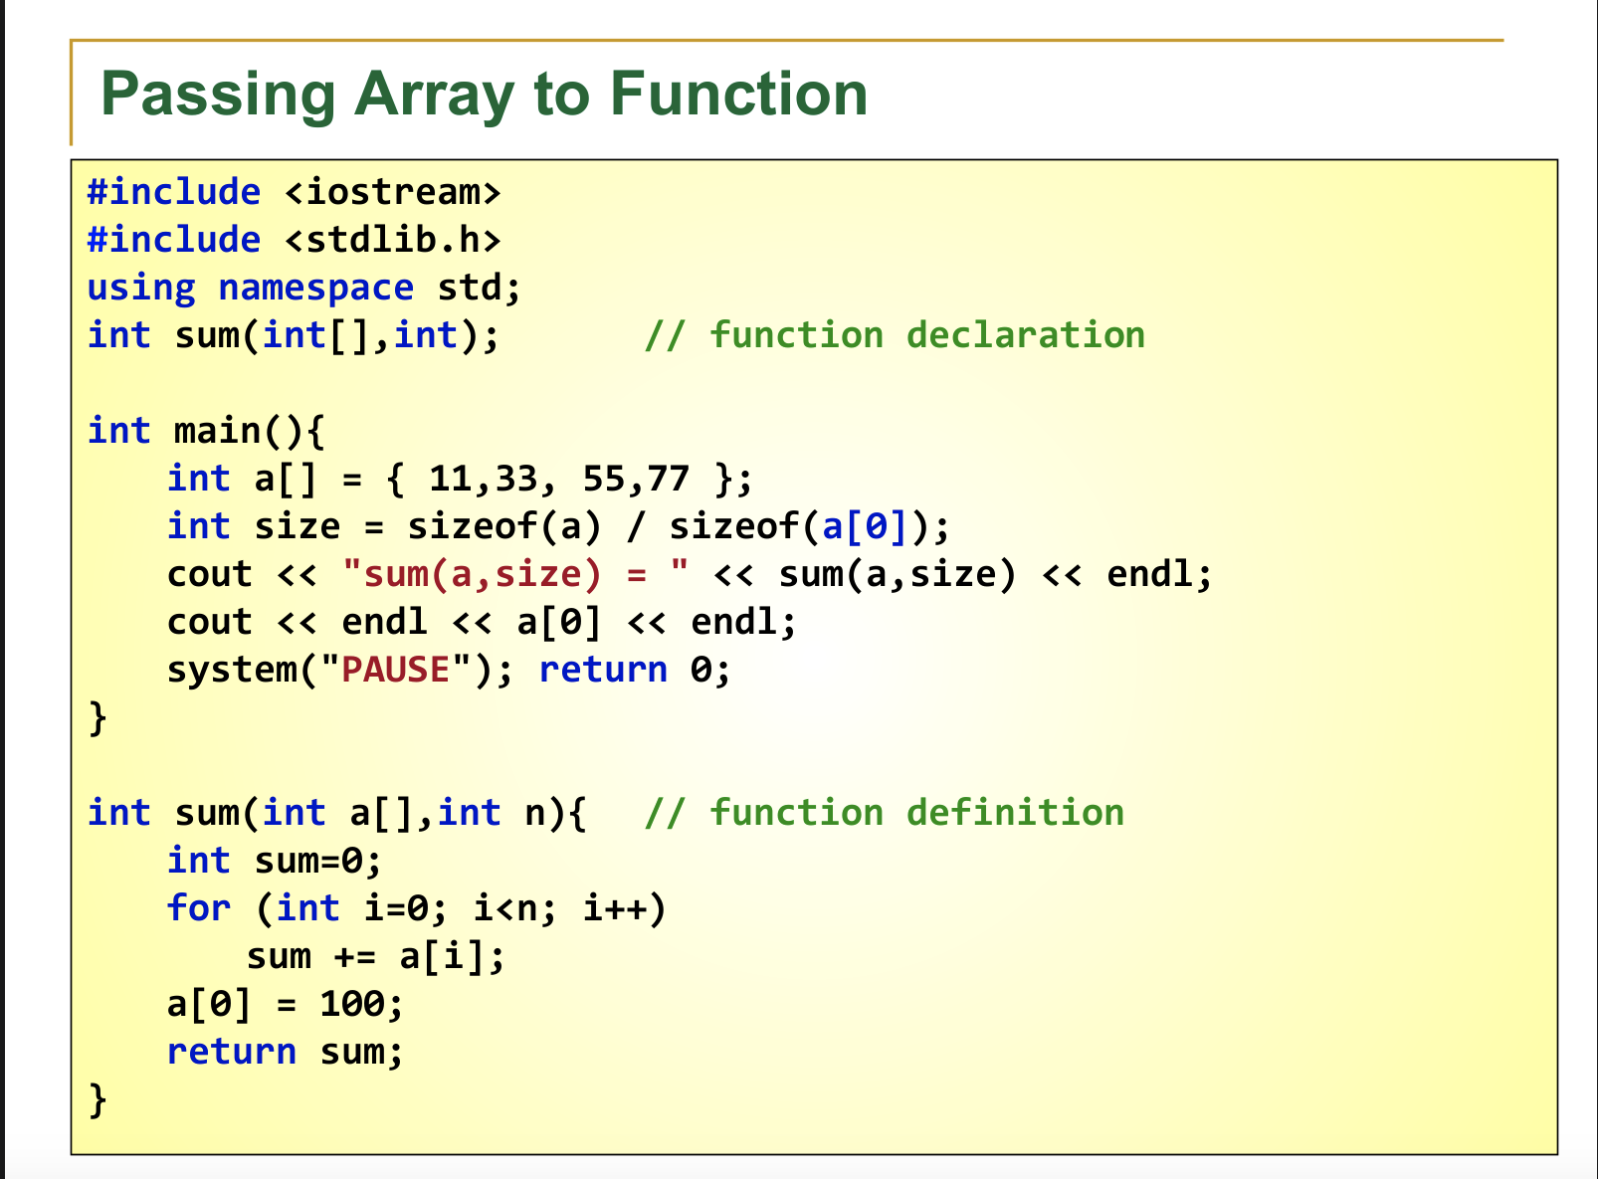

Slide 6
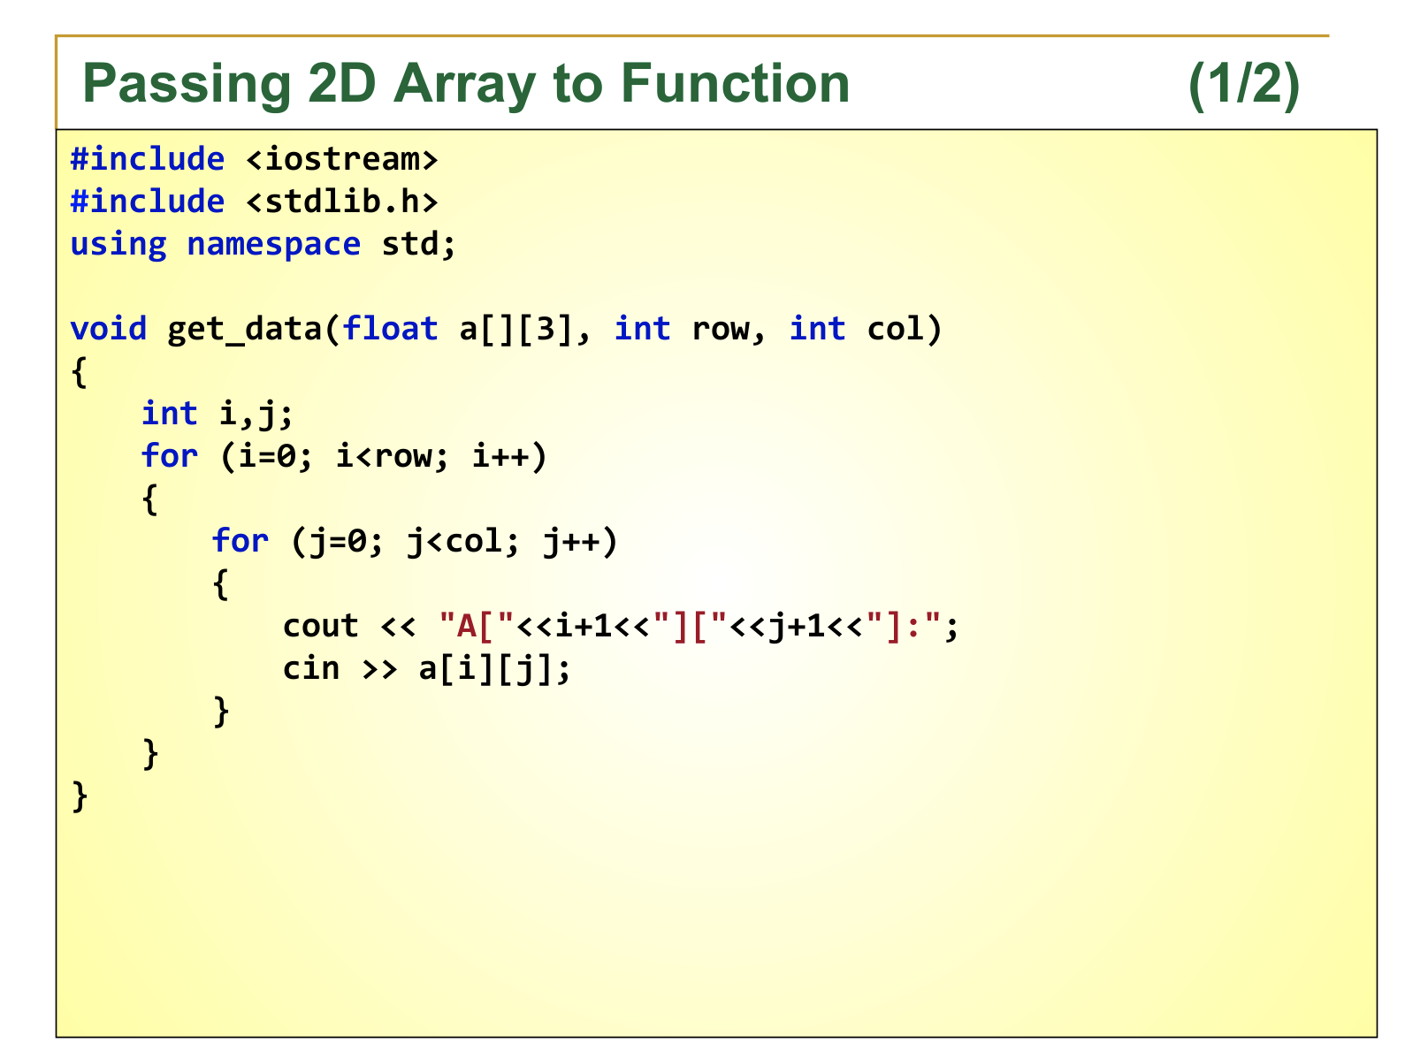

Slide 7
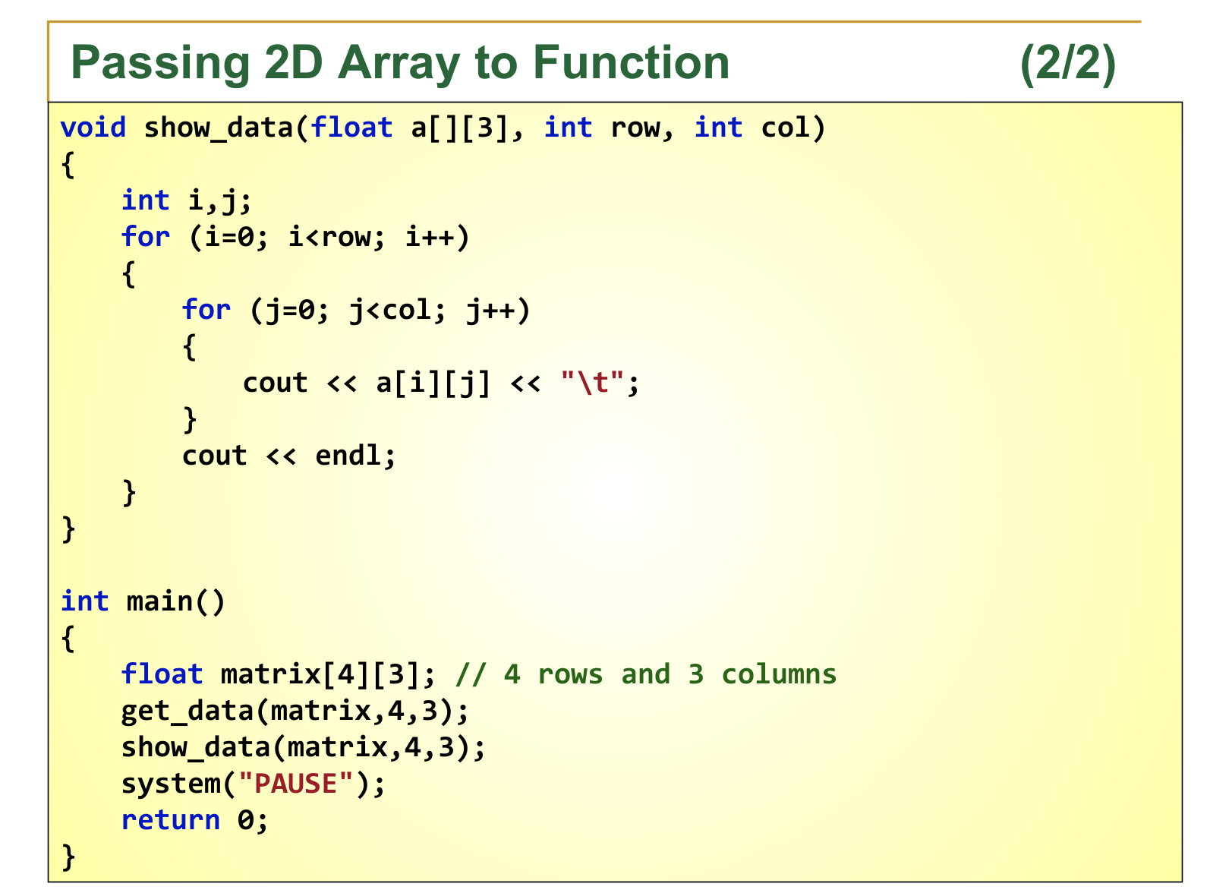

Slide 8
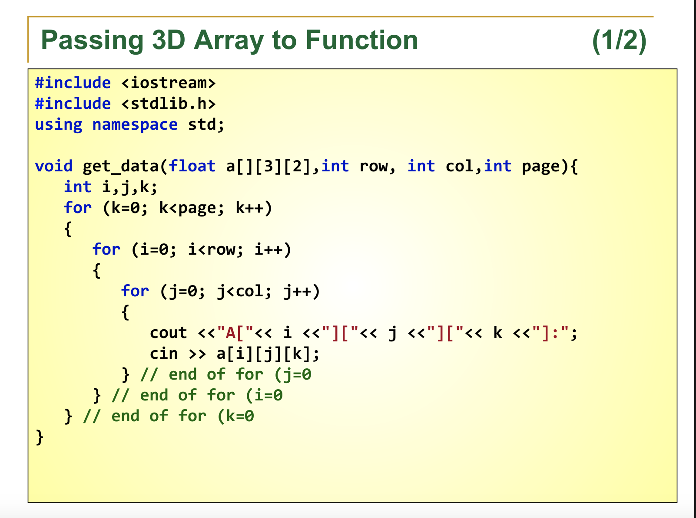

Slide 9
